Slide 1
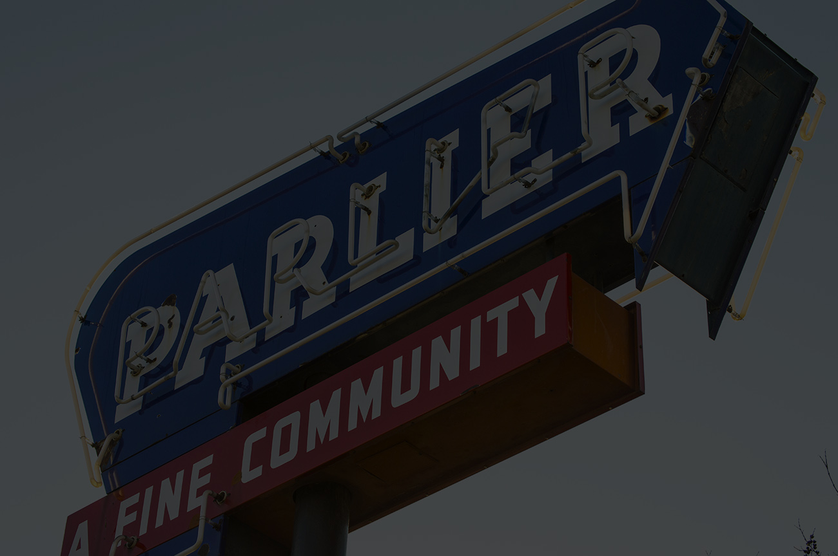
City of Parlier Budget FY 2020-21
General Fund

Slide 2
Budget Impacts
COVID-19
In-shelter order caused drop in sales tax, rent, charges for services, and gas tax, expect 25-50% drop
General Fund is already predicted to started off with a fund balance $2,500,000 deficit
Fiscal year ending June 30, 2020 will probably closed with a $1,500,000+ deficit
Heritage Park contributed to the $1,000,000 in deficit
Cuts is recommended and the biggest savings would be in personnel costs
General Fund has ZERO cash, funding their costs with pooled money from other funds
Things to Know

Slide 3
General Fund
Unrestricted funds that can be used for any purposes
Public safety
Park maintenance
Administration
Community development
Fire
Animal control

Slide 4
General Fund Revenue Sources
Projected Revenue Sources

Slide 5
2020-21 General Fund Revenue Budget
City averages $3 million in revenues
Revenue Source | Budgeted Amount
Property and Sales Tax | 2,400,000
Permits and Business License | 180,000
Fines | 50,000
Rental Income | 20,000
COPS from County | 140,000
Charges for Services | 120,000
Other Miscellaneous | 68,000
Grant, Police related | 122,000
TOTAL REVENUES | 3,100,000
Impact to General Fund Revenue
Expect a 25%-50% drop in sales tax, rental income, permits, and recreational activities due to COVID-19
Did not budget for marijuana sales tax, what the City gets from that should be used towards getting the $2,500,000 deficit down

Slide 6
General Fund Revenues Summary

Slide 7
General Fund Expense

Slide 8
General Fund Expenses
2020-21 General Fund Expense Budget
General Fund Expense Notes
Expense By Function | Budgeted Amount
General Government | 520,000
Public Safety | 2,560,000
Public Works | 56,400
Community Development | 300,000
Parks and recreation | 180,000
Capital outlay | 0
TOTAL EXPENSES | 3,616,400
Excluding the $1 million Heritage Grant General Fund shortfall, General Fund is operating at $500,000 loss
Furloughs, for every 8 hours furlough, City can save $60,000 (Police)
$97,000 Citywide excluding daycare
Consider cutting special events not grant funded
Limit travel and conferences
Contract limits and amendments
Deferred Park maintenance
No over-time
Consider reducing FT to PT
8

Slide 9
General Fund Expense Summary

Slide 10
General Fund Deficit Recap
Large image
Summary of General Fund Deficit

Slide 11
General Fund Deficit
-$3,016,400 PROJECTED AT MINIMUM
July 1, 2020 DEFICIT | -2,500,000
FY20-21 Projected Revenues | 3,100,000
FY20-22 Projected Expenses | -3,616,000
June 30, 2021 DEFICIT | -3,016,400

Slide 12
Future Goals
Short-term
Start putting money aside to build a reserve for emergencies and capital improvements
Get out of a deficit fund balance
Get timely financial reports to monitor current financial activities
Find other general fund revenue sources

Slide 13
Thank You
Lan Kimoto
+5592819342
lankimoto@yahoo.com
Bryant L. Jolley, CPA

